Slide 1
Koffein Flu Prediction - Demo
Czinege Lajos, Jurás Dorka, Kovács Zsolt, Madar Boglárka

Slide 2
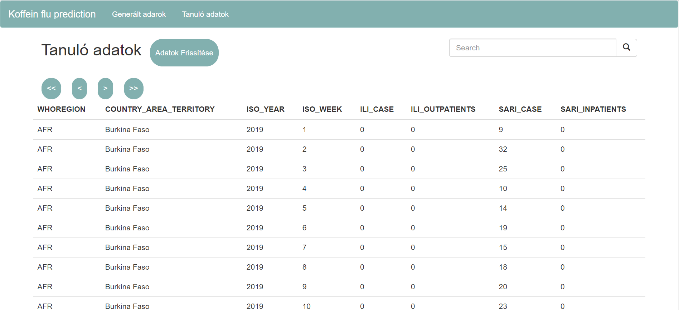
Website
Backend
HTML5
CSS3
Bootstrap
Python backend with Django

Slide 3
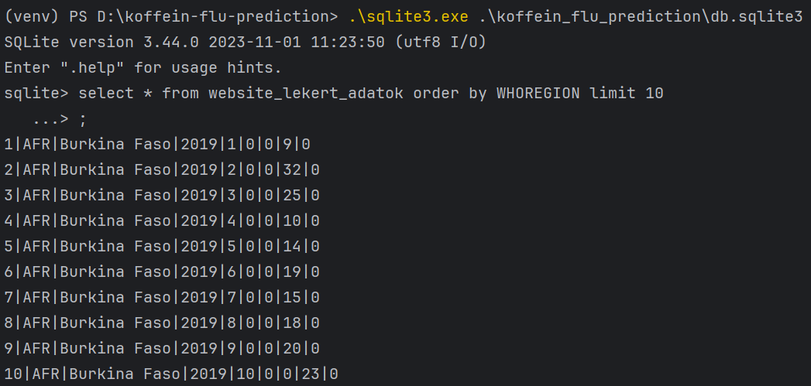
Database
SQLite database
Tables
Learning data (Official WHO dataset)
Generated data

Slide 4
New Data Generator
Tensorflow + Keras model
Neural network
Model trained on learning dataset (filtered official WHO dataset)
Evaluated on the full learning dataset
Generates 4 week of data from the past 8 weeks

Slide 5
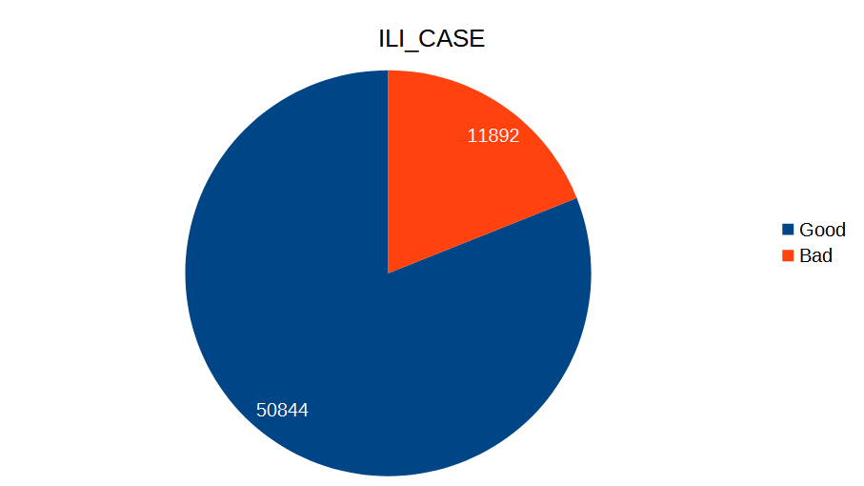
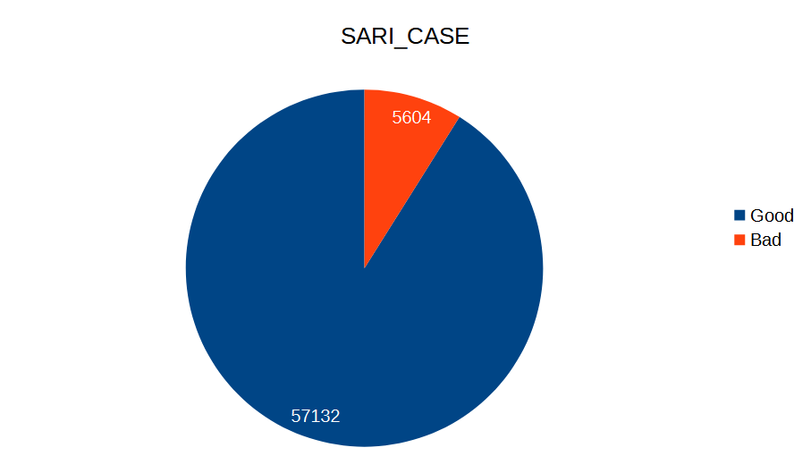
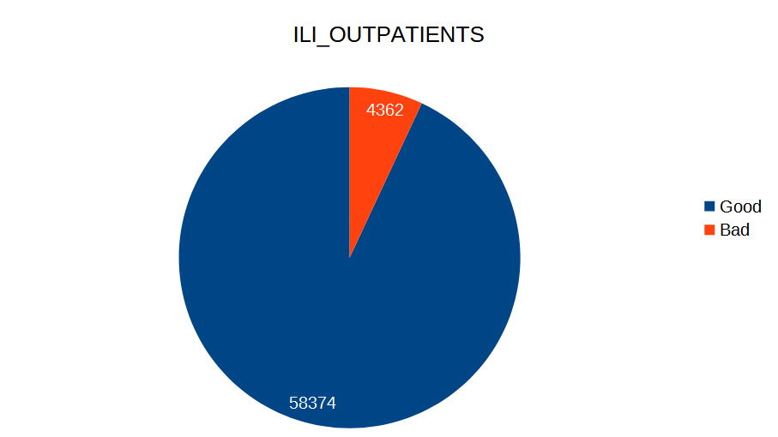

New Data Generator
Good - the difference between the predicted and the actual data is max 20%

